Slide 1



CISE REU Evaluation Toolkit
Audrey Rorrer, PhD
University of North Carolina at Charlotte
College of Computing & Informatics
audrey.rorrer@uncc.edu

Slide 2
Evaluation & Assessment Considerations
Toolkit Resources
Recruiting
Etc.
Student Outcomes
Evaluation 101
NSF CISE REU New PI Meeting, Arlington, VA, March 2017

Slide 3

Intentional Evaluation
What is the vision?
  Project goals
  Student impact
  Resources & support
  Milestones
What evidence is needed?

Slide 4
Eval 101: REU Program Outcomes
Applicants
  Applied vs Accept
  Demographics
  Limited research access
Participants
  Attitudes, Behaviors, Cognition (skills, knowledge)
  Experiences, Activities
  Longitudinal outcomes
Program Outcomes
  Publications
  Dissemination
  Products
Specialty
  Mentoring?
  Graduate student development?
  Other Contributions

Slide 5
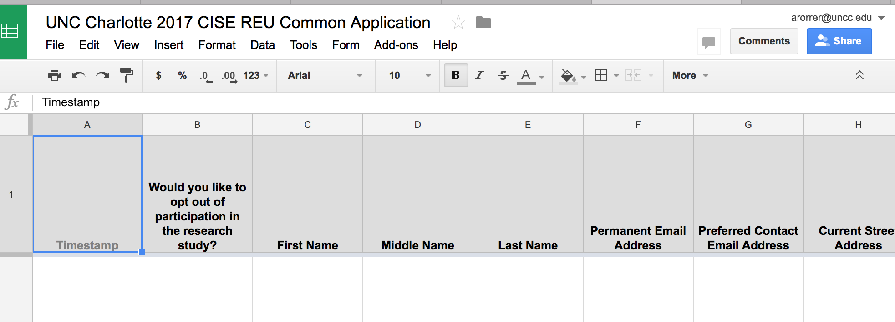
Recruiting Resources: Common Application
56 items covering contact information, academic preparation, graduate school plans, demographic information
Customizable (theme, items, next steps information)
  Immediate access to your applicants
  Manages student data in a form
No tool for references, resumes, or transcripts
What PI Sees

Slide 6
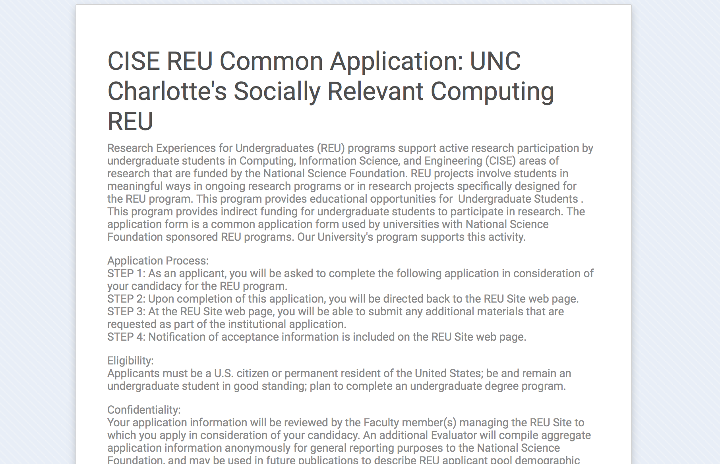
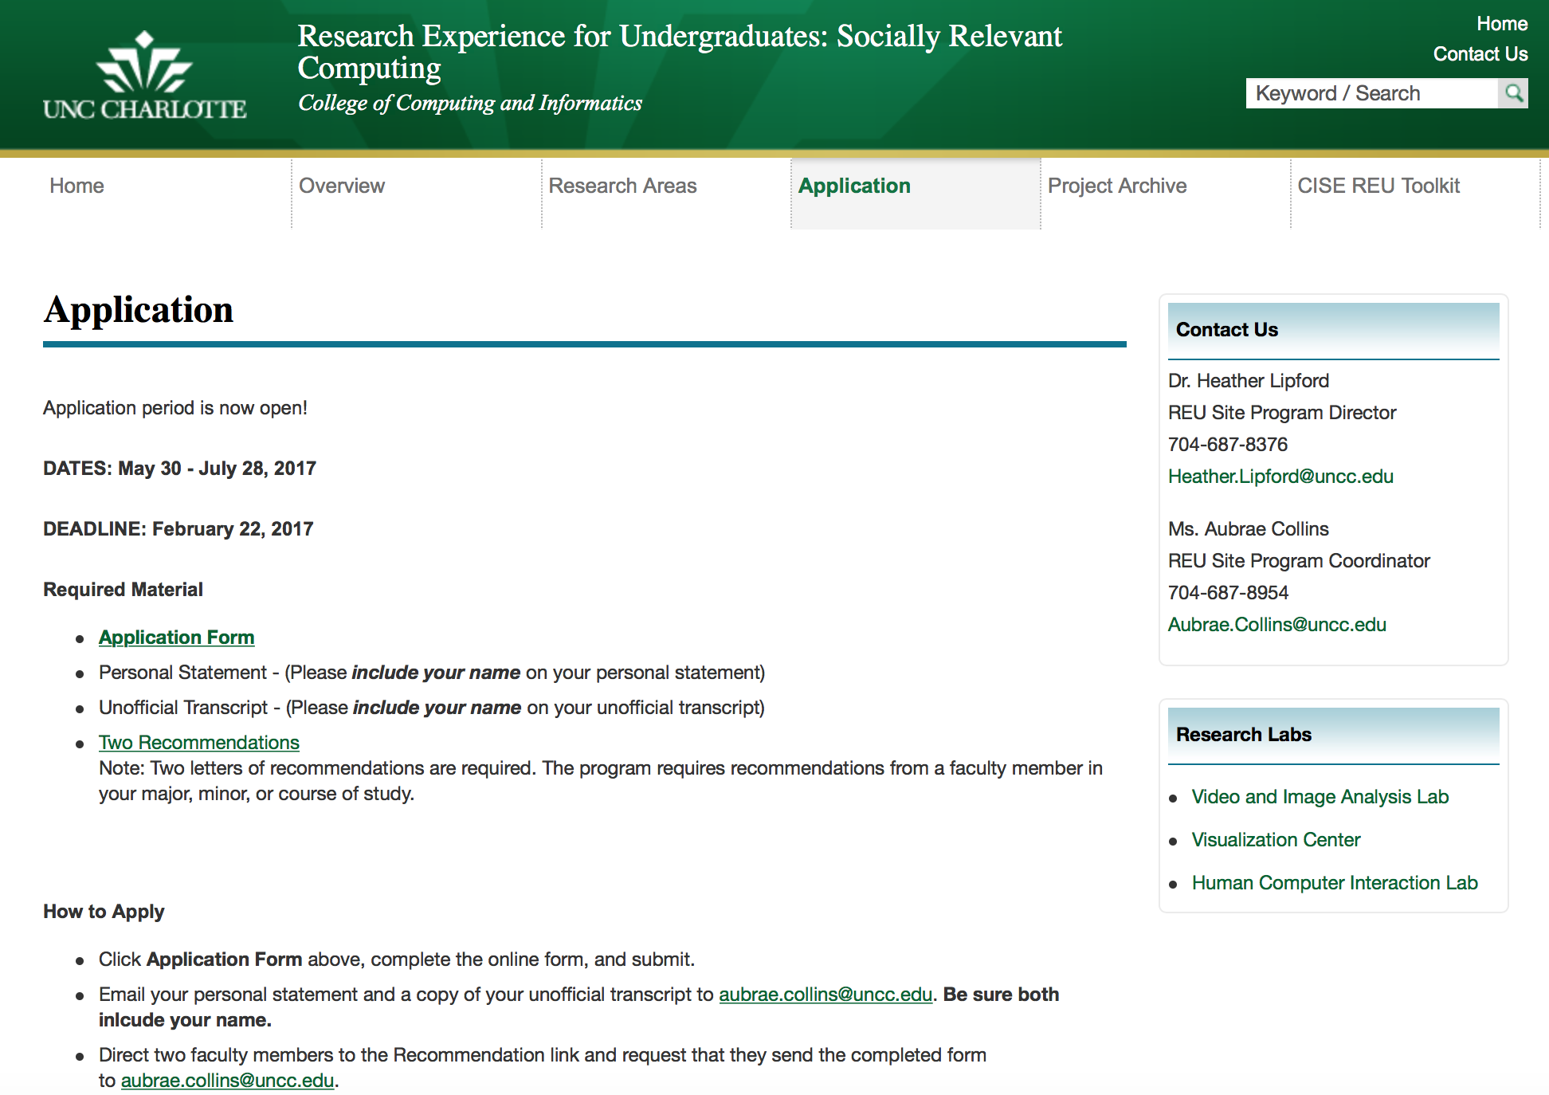
Recruiting Resources: Common Application
What Applicant Sees

Slide 7
Recruiting Resources: Applicant Sharing
Fall: advertise
Winter: select
Spring: share
1. Advertise on GoogleDoc
Students are directed to you
2. Shared Applicant Pool
You contact students from other sites

Slide 8
Results: Common Application Trends
Site Descriptors | 2010 (N=13) | 2011 (N=20) | 2012 (N=22) | 2013 (N= 26) | 2014 (N=25) | 2015 (N= 23) | 2016 (N= 27)
Range of # Applicants | 29-152 | 4-176 | 18-212 | 20-299 | 29-232 | 15- 349 | 27- 286
Avg Applications per Site | 77 | 79 | 93 | 112 | 102 | 122 | 108
Largest # of Sites Applied to by Individual | 30 (n=1) | 6 (n=1) | 7 (n=2) | 18 (n=1) | 14 (n=1) | 16 (n=1) | 9 (n=3)
% of Female Applicants | 27% | 26% | 24% | 28% | 27% | 26% | 32%
% of URM Applicants | 28% | 34% | 36% | 31% | 31% | 35% | 33%

Slide 9
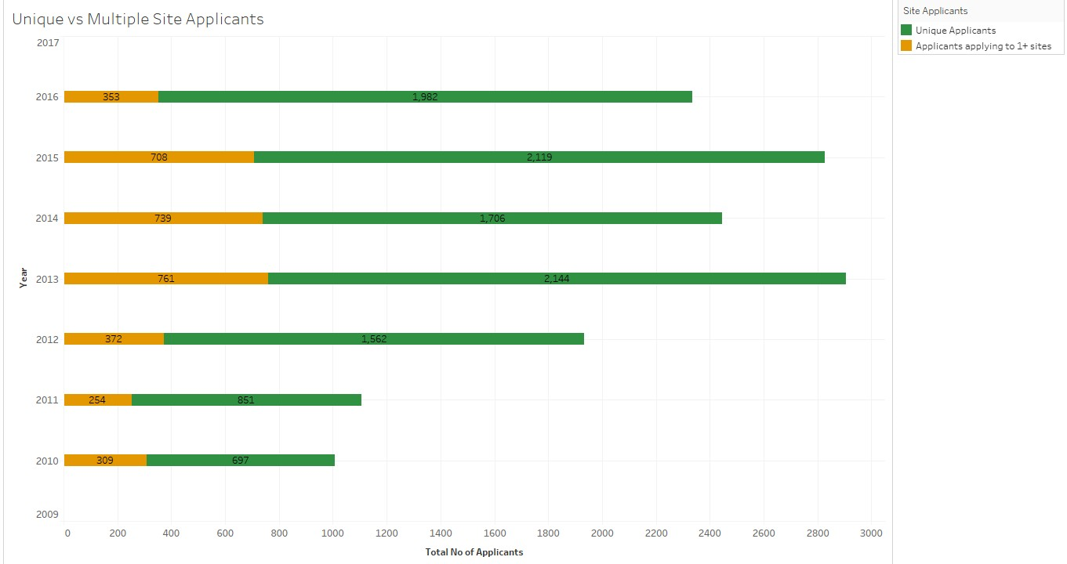
Applicant Counts: Sites Applied To
= 2335
= 2827
= 2445
= 2905
= 1934
= 1105
= 1006

Slide 10
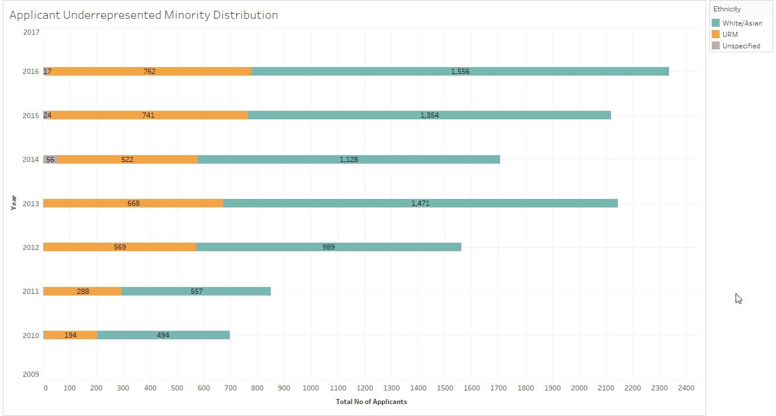
Applicant Demographic Trends:
Underrepresented Minority Distribution
33%
35%
31%
31%
36%
34%
28%

Slide 11
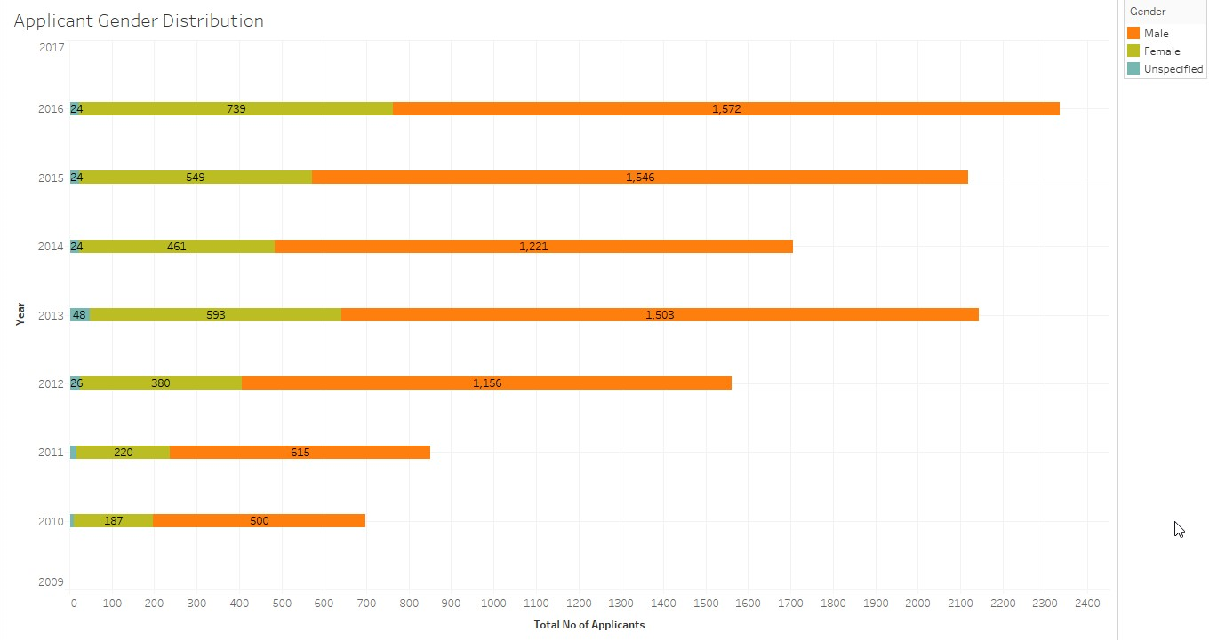
Applicant Demographic Trends:
Gender Distribution
32%
26%
27%
28%
24%
26%
27%

Slide 12
Common Applications: Graduate School Plans
Majority plan to pursue graduate degrees
  79% in 2013
  80% in 2014
  84% in 2015
  79% in 2016
Few are first generation college students
  Less than 20% across all 6 years
  17% are first person in family to attend college (2015)
  19% are first person in family to attend college (2016)

Slide 13
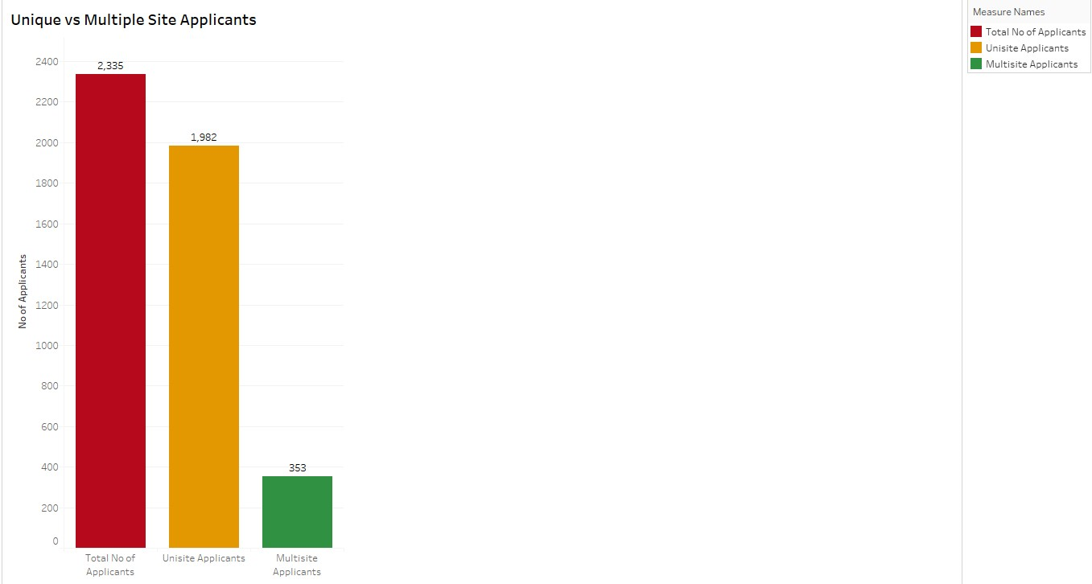
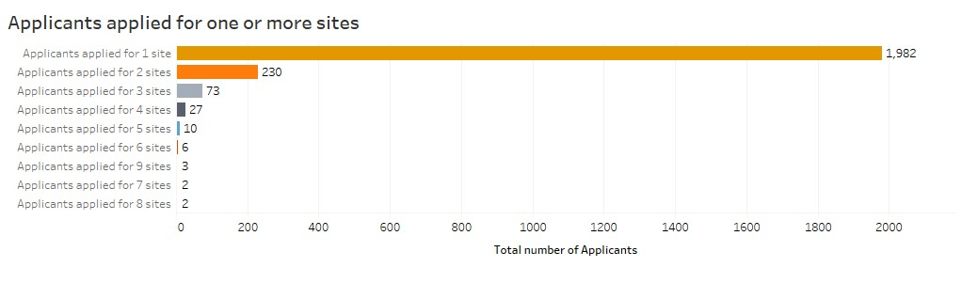
2016 Common Applicants: Unique

Slide 14
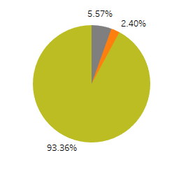
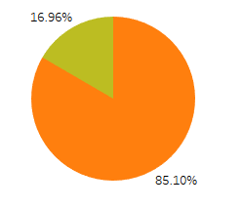


2016 Common Applicants: Consent
Percentage of applicants who answered 'Yes' to have their application considered by additional CISE REU programs
Percentage of applicants who answered 'yes' to opt out of participating in the research study

Slide 15
Student Outcomes: A la Carte Student Survey
Pre and Post-Test
Post-Test Only
Self-Efficacy
Research Skills
Help-Seeking
Mentoring
Graduate School Intent
Leadership
Grit
Program Satisfaction
Attitudes
Professional Identity

Slide 16
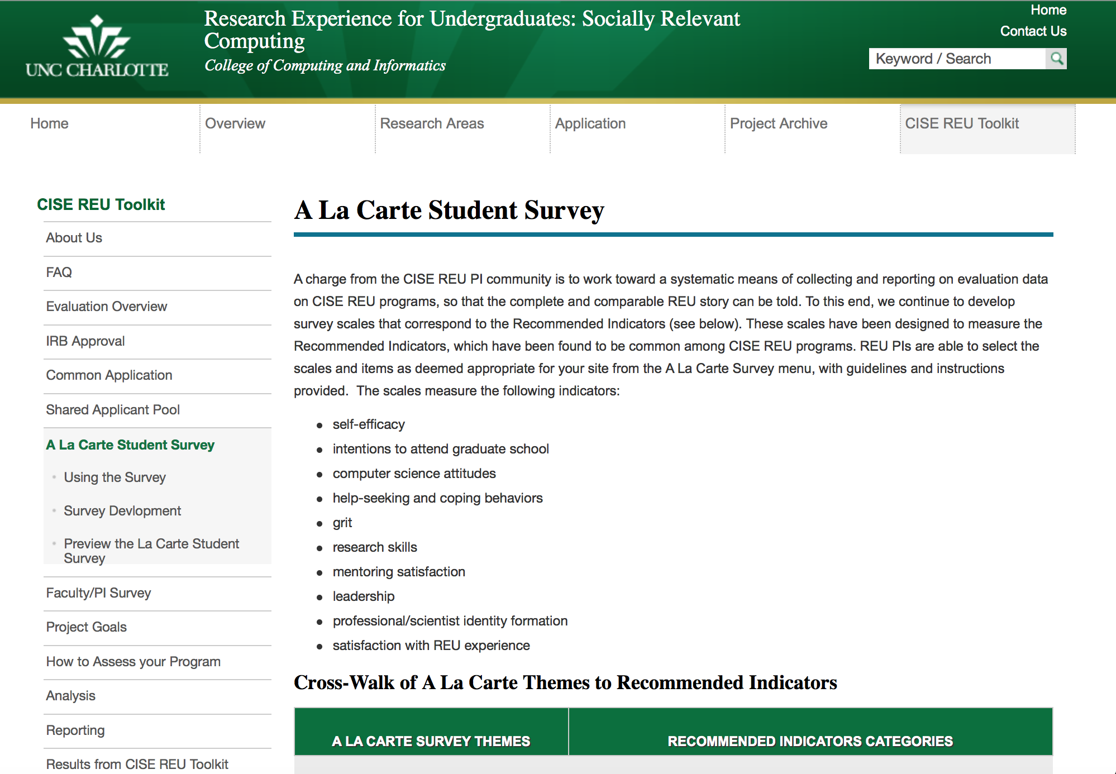
Student Outcomes: How Survey Works
Deployment Options
Toolkit Administered
Data collection and analysis done for you
Data package = your site data (raw and coded), code book, results
Anonymized data
PI Administered
Site collects and analyzes
Identified

Slide 17

Student Outcomes: Data Package
Raw and Coded data of pre and post responses
Matched Pairs data
Code Book
Analysis of pre/post data
Data is de-identified

Slide 18
Results: A la Carte 2016
Significant Effects for Time (pre- and post- surveys, *(p<.05)
Construct | Pre (SD) N= 305 | Post (SD) N= 268
Self-Efficacy* | 3.67 (.61) | 4.21 (.53)
Intent to Grad School* | 3.83 (.75) | 3.7 (.88)
Attitudes* | 4.33 (.51) | 4.09 (.74)
Help-Seeking/ Coping | 4.27 (.61) | 4.35 (.64)
Research Knowledge* | 3.15 (.66) | 3.92 (.59)
Grit | 3.36 (.35) | 3.39 (.40)
Scientific Identity* | 3.42 (.91) | 3.68 (1.0)
Leadership* | 4.18 (.60) | 4.30 (.65)
Mentorship | Not applicable | 4.38 (.84)
Descriptives:
43% Female
35% multi-ethnic minority groups
Predominantly Rising Juniors and Seniors
Note: 5 pt Likert scale

Slide 19
A la Carte Student Survey
Modular, pre/post assessment of student outcomes
Self Efficacy
  I can formulate a research problem
Intent to attend graduate school
  I plan to apply to graduate school in a computing discipline
Attitudes towards computing
  I like to use computer science to solve problems
Help seeking/coping skills
  When I do poorly on an exam, typically I….skip class
GRIT
  I am a hard worker
Research Skills
  Formulate a research hypothesis
  Write a research paper for publication
Leadership in Science
  I know how to be good team member
  I know how to encourage team performance
Professional Identity as Scientist
  I feel like I belong in science
Mentoring Satisfaction (post-only)
  My mentor was helpful in providing direction and guidance on research project issues

Slide 20
Survey Instruments Available
SURE- Survey of Undergraduate Research Experiences
  D. Lapatto at Washington University
URSSA- Undergraduate Research Student Self Assessment
  University of Colorado Boulder, NSF
  Both are free for research programs and courses
  Adaptation made for the A la Carte
Notes:
Lapatto’s survey created at Washington University (St. Louis) and he deployed to Howard Hughes Medical Institute; his population was 380 liberal arts students; found no institutional differences and more similarity between ethnicity and gender
http://www.ncbi.nlm.nih.gov/pmc/articles/PMC533131/
https://www.grinnell.edu/academics/areas/psychology/assessnebts/sure-iii-survey

Slide 21
Etc.: Additional Considerations
IRB
Longitudinal Tracking
Outcomes of Interest
Campus Resources

Slide 22
Future Toolkit: Alumni Tracking
Working Group
March 2016
Discussion & Ideas
Develop Prototypes
Feedback & Launch
Working Group Members:
Lazaros Gallos, Rutgers
Claire Duggan, Northeastern U.
Bonnie Swan, U. Central Florida
Stephen Gilbert, Iowa State
Tiffany Reardon, Berkeley
Huirong Fu, Oakland
Jamie Payton, UNC Charlotte
Raja Kushalnagar, RIT

Slide 23
Online Evaluation Toolkit
Evaluation Toolkit: reu.uncc.edu/cise-reu-toolkit
How To videos
Common Application
Google Form application UNIQUE to site
Standardized & customizable
Shared Applicant Pool
Student Outcomes: modulated, valid/reliable
Faculty Impact: Survey deploying summer 2016
Under construction
Surveys: A la Carte and Faculty
All PIs have access to online folder
Managed via Google Drive & Common Applications
Site PI “releases” unselected candidates
Alumni Tracking
Evaluation materials and resources tailored to CISE REU
Aggregate descriptive statistics across CISE directorate
Join the working group

Slide 24
History of Evaluation Project
2009 Working Group Members
Guy Alain Amousou Chris Aberson Wendy Cooper Teresa Dahlberg Andy Fagg Stephen Gilbert Manfred Huber Niels Lobo
Sanjay Madrias Joan Peckham Eric Wong Yu-Dong Yoa
Kevin Zeng
Needs Assessment & Study
Established Common Indicators & Tools
Research Module Inclusive Terminology
Shared Applicant Pool
New Modules Faculty Study
Alumni Tracker
Instructional Videos
2009
Humbolt State
2010
UNC Charlotte
2013
2014-16
Toolkit Expansion Project

Slide 25
reu.uncc.edu/cise-reu-toolkit
Thank you audrey.rorrer@uncc.edu

