Slide 1
CISE REU Evaluation Toolkit 2020 Summative Report for Summer Programs
Audrey Rorrer, PhD
Research Associate Professor, Computer Science
UNC Charlotte

Slide 2
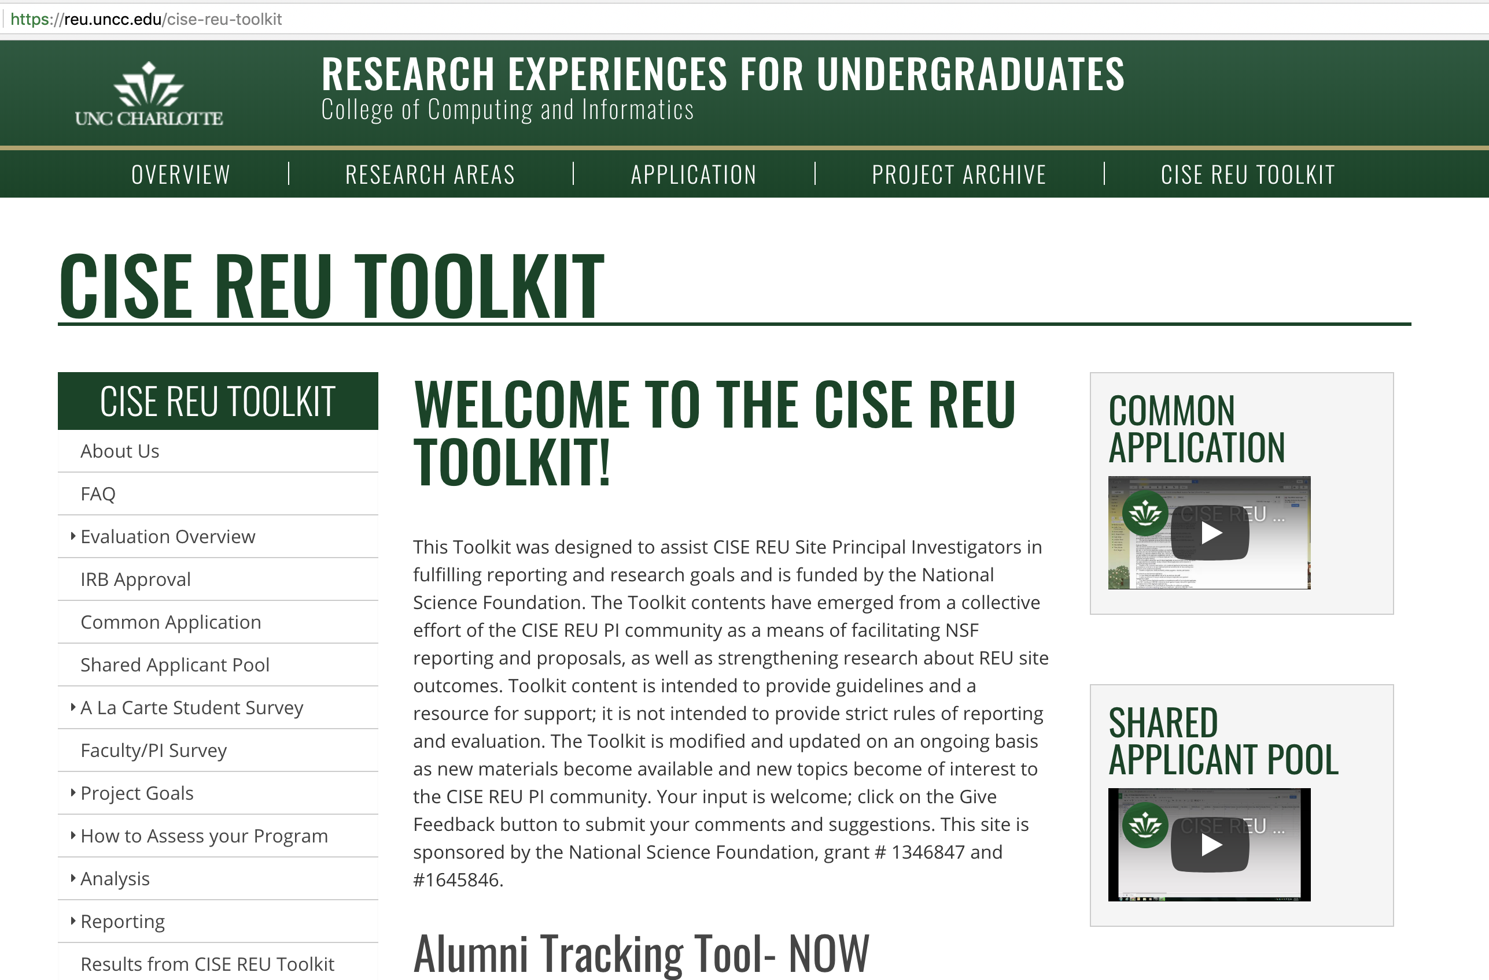
Overview of CISE REU Evaluation Toolkit
Purpose
Educate and support CISE REU PIs in site evaluation
Inform CISE community of aggregate outcomes
Tools
Common Application
Shared Applicant Pool
A la Carte Survey
Alumni Tracking Tool

Slide 3
Summary of Common Applications
 | 2010 | 2011 | 2012 | 2013 | 2014 | 2015 | 2016 | 2017 | 2018 | 2019 | 2020
# Sites Used | 13 | 20 | 22 | 26 | 25 | 23 | 27 | 33 | 46 | 51 | 18
Unique Appliants | 637 | 851 | 1562 | 2144 | 1706 | 2119 | 1982 | 2759 | 3456 | 3205 | 1573
% Female | 27% | 26% | 24% | 28% | 27% | 26% | 32% | 27% | 29% | 33% | 32%
% URM* | 28% | 34% | 36% | 31% | 31% | 35% | 33% | 26% | 28% | 29% | 36%
URM= all ethnicities except Caucasian and Asian

Slide 4
Survey Overview
Construct | Origin
Self-Efficacy | Bandura (1997); LAESE (AWE Assessment Project)
Grad School | Ajzen’s (2001) theory of planned behavior
Attitudes | Hoegh & Moskal (2009)
Help-Seeking | Struthers, Perry & Menec (2000)
Grit | Duckworth & Quinn (2009)
Research Skills | Survey of Undergraduate Research Experiences (Lopatto)
Scientific Leadership | Chemers, et al. (2011)
Scientific Identity | Chemers, et al. (2011)
Mentoring (post) | Berk, et al. (2005)
Satisfaction (Post) | Working Group
5 point likert scale Items
Piloted in 2010
Deployed as Pre/Post annually

Slide 5
Sample Survey Items
Construct | Sample Item
FIRST ITEM | Please indicate the specific field applicable to your research project:
Self-Efficacy | I can understand research literature
Grad School | I plan to apply to graduate school in a computing discipline
Attitudes | I like to use [x] to solve problems
Help-Seeking | When I do poorly on an exam….
Grit | I am diligent
Research Skills | Formulate a research hypothesis
Scientific Leadership | I know how to be a good team member
Scientific Identity | I feel like I belong in science
Mentoring (post) | My mentor was approachable
Satisfaction (Post) | How satisfied were you with your research experience

Slide 6
2018
Survey Participants
86 Sites Deployed Survey
Pre Survey n = 468
Post Survey n = 365
URM= all ethnicities except Caucasian and Asian

Slide 7
2019
Survey Participants
93 Sites Deployed Survey
Pre Survey n = 730
Post Survey n = 606
URM= all ethnicities except Caucasian and Asian

Slide 8
2020
Survey Participants
9 Sites Deployed Survey*
Pre Survey n = 94
Post Survey n = 83
*Covid-19 disrupted many sites
URM= all ethnicities except Caucasian and Asian

Slide 9
2018 Findings*
+
Self-Efficacy
Help Seeking/Coping
Grit
Research Skills
Leadership
Identity
-
Graduate Intent
Attitude
*These are matched pairs.
Construct | Pre-Survey | Post-Survey | P
Self-Efficacy | 3.62(0.68) | 4.13(0.69) | <.001
Graduate School | 3.77(0.78) | 3.74(0.91) | .63
Attitudes | 4.30(0.54) | 4.09(0.75) | <.001
Help-Seeking/Coping | 4.20(0.70) | 4.28(0.67) | .24
Grit | 3.38(0.41) | 3.46(0.48) | .002
Research Skills | 3.19(0.71) | 3.84(0.59) | <.001
Leadership | 3.97(0.76) | 4.18(0.77) | <.001
Identity | 3.36(0.94) | 3.59(1.00) | <.001
Mentoring | NA | 4.41(0.74) | NA
Satisfaction | NA | 4.32(0.60) | NA

Slide 10
2019 Findings*
+
Self-Efficacy
Grit
Research Skills
Leadership
Identity
-
Graduate Intent
Attitude
*These are matched pairs.
Construct | Pre-Survey | Post-Survey | P
Self-Efficacy | 3.53(0.77) | 4.25(0.57) | <.001
Graduate School | 3.89(0.67) | 3.85(0.85) | .08
Attitudes | 4.24(0.61) | 4.07(0.87) | <.001
Grit | 3.80(0.50) | 3.81(0.54) | .40
Research Skills | 3.08(0.80) | 3.90(0.65) | <.001
Leadership | 4.12(0.68) | 4.24(0.65) | <.001
Identity | 3.47(0.89) | 3.70(0.97) | <.001
Mentoring | NA | 4.45(0.71) | NA
Satisfaction | NA | 4.35(0.60) | NA

Slide 11
2020 Findings:
+
Self-Efficacy
Research Skills
Sense of Belonging
-
Attitudes decreased
Sense of Belonging was added:
- to address known persistence factors in literature
- to investigate community among virtual sites (covid-19)
Construct | Pre-Survey | Post-Survey | P
Self-Efficacy | 3.15 (.78) | 4.41* (.56) | .000
Graduate School | 3.90 (.79) | 3.77 (.92) | .293
Attitudes | 4.41 (.54) | 4.17* (.72) | .012
Grit | 3.36 (.41) | 3.46 (.37) | .096
Research Skills | 2.98 (.80) | 3.76* (.63) | .000
Leadership | 4.15 (.67) | 4.31 (.60) | .094
Identity | 3.34 (.92) | 3.51 (.98) | .195
Belonging | 3.91 (.75) | 4.16* (.71) | .024
Mentoring | NA | 4.56 (0.70) | NA
Program Satisfaction | NA | 4.35 (0.59) | NA
Virtual Sites developed student skills, confidence and community

Slide 12
Summary of Survey Outcomes+
Construct | 2010 |  | 2011 |  | 2012 |  | 2013 |  | 2015 |  | 2016 |  | 2017 |  | 2018 |  | 2019 |  | 2020
 | Pre | Post | Pre | Post | Pre | Post | Pre | Post | Pre | Post | Pre | Post | Pre | Post | Pre | Post | Pre | Post | Pre | Post
Self-Efficacy | 3.05 (0.47) | 3.43 (0.40) | 3.11 (0.47) | *3.48 (0.39) | 3.75 (0.69) | *4.06 (0.79) | 3.81 (0.74) | *4.34 (0.53) | 3.87 (0.64) | *4.34 (0.59) | 3.67 (0.61) | *4.21 (0.53) | 3.71 (0.62) | *4.08 (0.93) | 3.67 (0.64) | *4.13 (0.68) | 3.56 (0.75) | *4.24 (0.56) | 3.15 (.78) | 4.41* (.56)
Graduate School Intent | 3.10 (0.46) | 3.19 (0.47) | 3.22 (0.59) | 3.23 (0.66) | 3.93 (0.75) | 3.93 (0.79) | 3.89 (0.65) | *4.06 (0.70) | 3.86 (0.79) | 3.78 (0.89) | 3.83 (0.75) | *3.7 (0.88) | 3.84 (0.77) | 3.67 (1.04) | 3.77 (0.78) | 3.75 (0.92) | 3.90 (0.67) | 3.84 (0.83) | 3.90 (.79) | 3.77 (.92)
Attitudes | 3.59 (0.32) | 3.65 (0.29) | 3.67 (0.36) | 3.70 (0.38) | 3.58 (0.24) | *4.55 (0.49) | 4.39 (0.44) | 4.43 (0.47) | 4.33 (0.55) | 4.23 (0.66) | 4.33 (0.51) | *4.09 (0.74) | 4.36 (0.51) | *4.06 (0.97) | 4.33 (0.52) | 4.11 (0.77) | 4.26 (0.58) | 4.02 (0.89) | 4.41 (.54) | 4.17* (.72)
Help-Seeking/ Coping | 2.94 (0.33) | 2.98 (0.37) | 2.98 (0.39) | 2.98 (0.36) | 3.52 (0.48) | 3.48 (0.51) | 3.40 (0.48) | 3.47 (0.45) | 3.99 (0.49) | 4.01 (0.51) | 4.27 (0.61) | 4.35 (0.64) | 4.34 (0.62) | 4.29 (0.97) | 4.24 (0.70) | 4.29 (0.64)
Research Skills/ knowledge |  |  |  |  |  |  | 3.22 (0.74) | 4.00 (0.77) | 3.37 (0.69) | *4.04 (0.61) | 3.15 (0.66) | *3.92 (0.59) | 3.20 (0.64) | *3.82 (0.96) | 3.18 (0.67) | *3.84 (0.59) | 3.07 (0.78) | *3.89 (0.64) | 2.98 (.80) | 3.76* (.63)
Grit |  |  |  |  |  |  |  |  |  |  | 3.36 (0.35) | 3.39 (0.40) | 3.38 (0.34) | 3.31 (0.74) | 3.39 (0.43) | *3.47 (0.46) | 3.81 (0.49) | 3.85 (0.53) | 3.36 (.41) | 3.46 (.37)
Scientific Identity |  |  |  |  |  |  |  |  | 3.62 (0.88) | 3.81 (1.06) | 3.42 (0.91) | *3.68 (1.00) | 3.37 (1.03) | *3.47 (1.28) | 3.40 (0.94) | *3.59 (1.03) | 3.46 (0.89) | *3.72 (0.95) | 3.34 (.92) | 3.51 (.98)
Scientific Leadership |  |  |  |  |  |  |  |  | 4.24 (0.57) | *4.37 (0.56) | 4.18 (0.60) | *4.30 (0.65) | 4.09 (0.73) | *4.15 (1.07) | 4.00 (0.74) | *4.18 (0.77) | 4.14 (0.64) | *4.24 (0.66) | 4.15 (.67) | 4.31 (.60)
Sense of Belonging |  |  |  |  |  |  |  |  |  |  |  |  |  |  |  |  |  |  | 3.91 (.75) | 4.16* (.71)
Mentoring |  |  |  |  |  |  |  |  | N/A | 4.47 (0.74) | N/A | 4.38 (0.84) | N/A | 4.44 | N/A | 4.41 (0.74) | NA | 4.45 (0.71)
Gray indicates construct not used +These results are non-matched pairs
*statistically significant change at p<.05

Slide 13
Publications
Rorrer, A., Allen, J., and Zuo, H. (2018). A National Study of Undergraduate Research Experiences in Computing: Implications for Culturally Relevant Pedagogy. Association of Computing Machinery's 49th Technical Symposium in computing Science Education, https://doi.org/10.1145/3159450.3159510.
Rorrer, A., and Swan, B. (2017). Developing Inclusive Lab Climates for Undergraduate Research Programs: A National Study of Computing Faculty. ICERi 2017 Proceedings The 10th Annual International Conference on Education, Research and Innovation [to be published].
Rorrer, A. (2016). An Evaluation Capacity Building Toolkit for Principal Investigators of Undergraduate Research Experiences: A Demonstration of Transforming Theory into Practice, Evaluation and Program Planning, Volume 55, April 2016, Pages 103-111.

